Slide 1
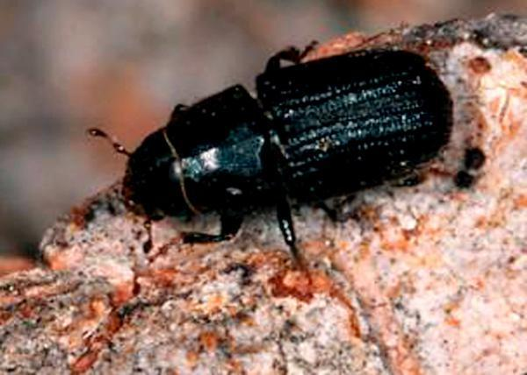
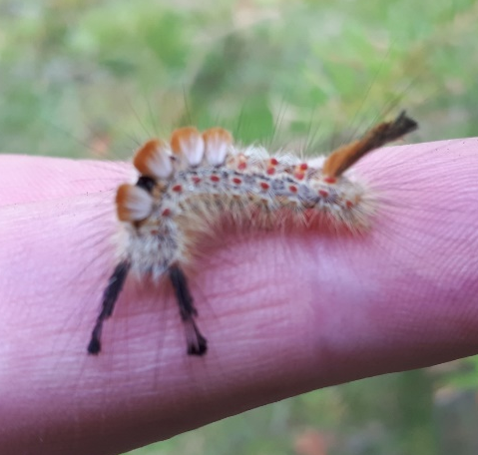
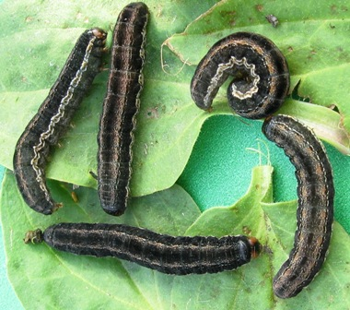
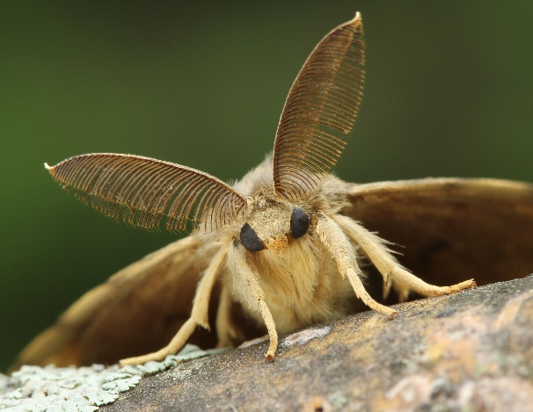
Update on Forest Health for RMT:
Kootenay Boundary Region
January 19, 2021
Marnie Duthie-Holt
Regional Entomologist

Slide 2
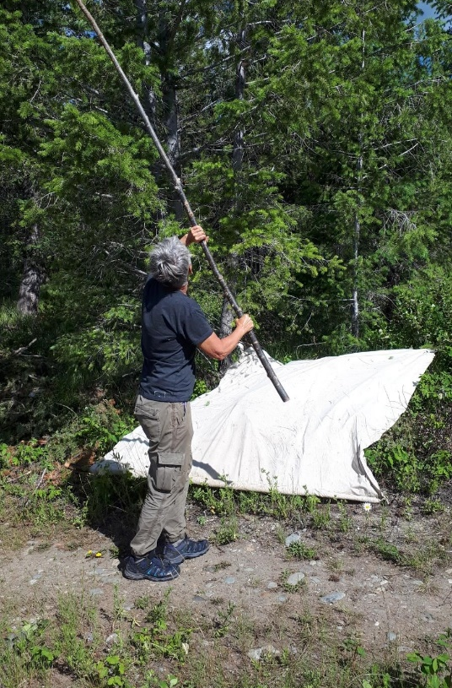
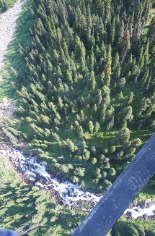
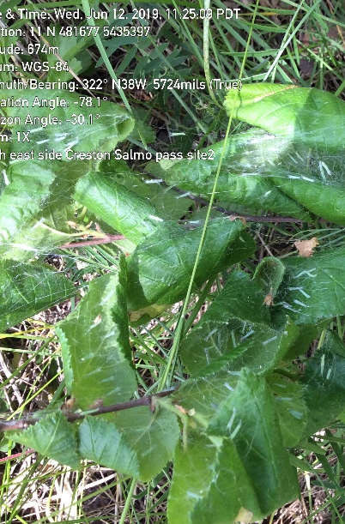
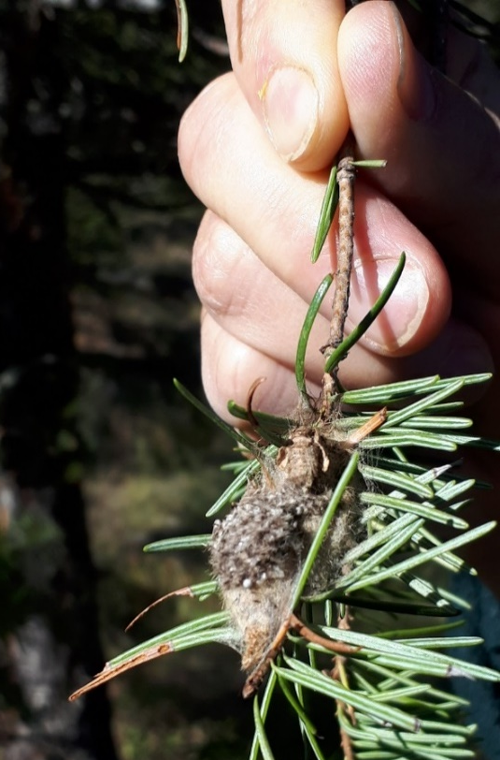
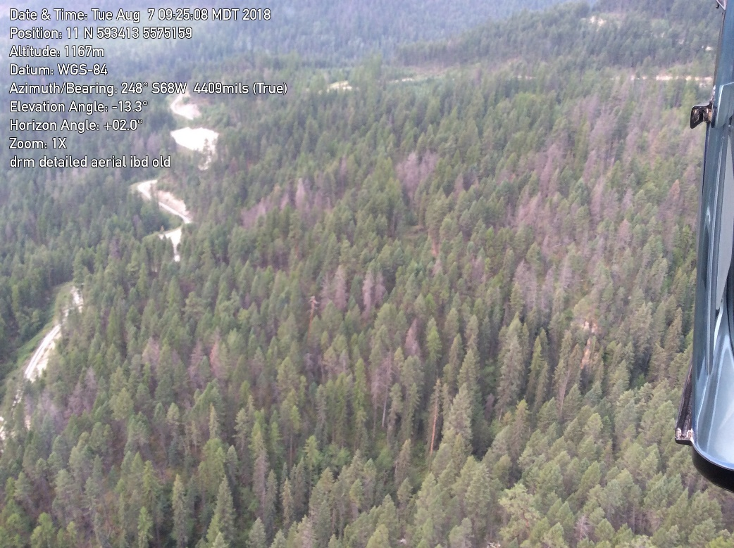
Overview
Regional Entomologist Role
  Monitor local FH conditions
  Assist in deliver operational programs
  Gather and analyze forest health research
  Provide extension and expert consultative services to local decision makers, industry, and the public
Pest status and research project updates

Slide 3
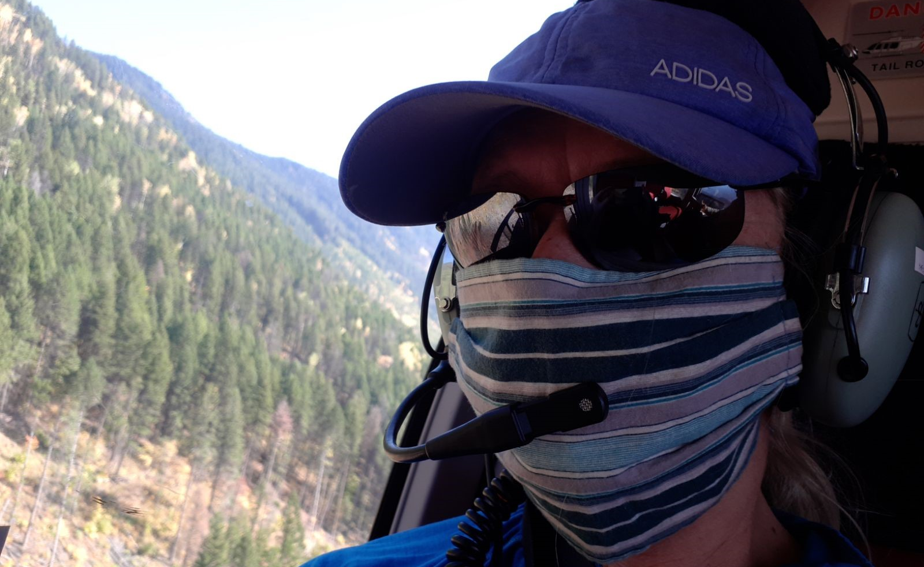
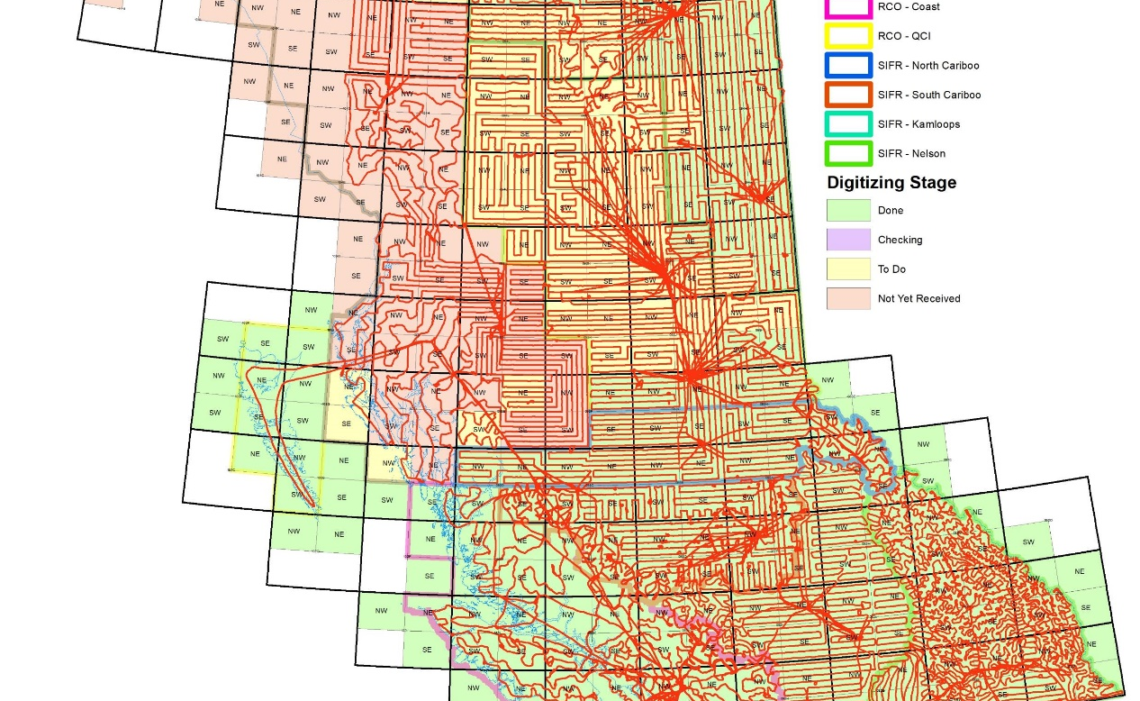
1. Monitor local FH conditions
Aerial Overview Surveys
  All biotic & abiotic factors
  Data 1920-present
  100% coverage KBR
  88% provincial coverage (highest since 2014 despite COVID)
  18 surveyors, 10 aircraft companies
  728 flight hours (128 days) July 5th- Sept 22nd
Long term monitoring
Historical trends
Climate change impacts

Slide 4
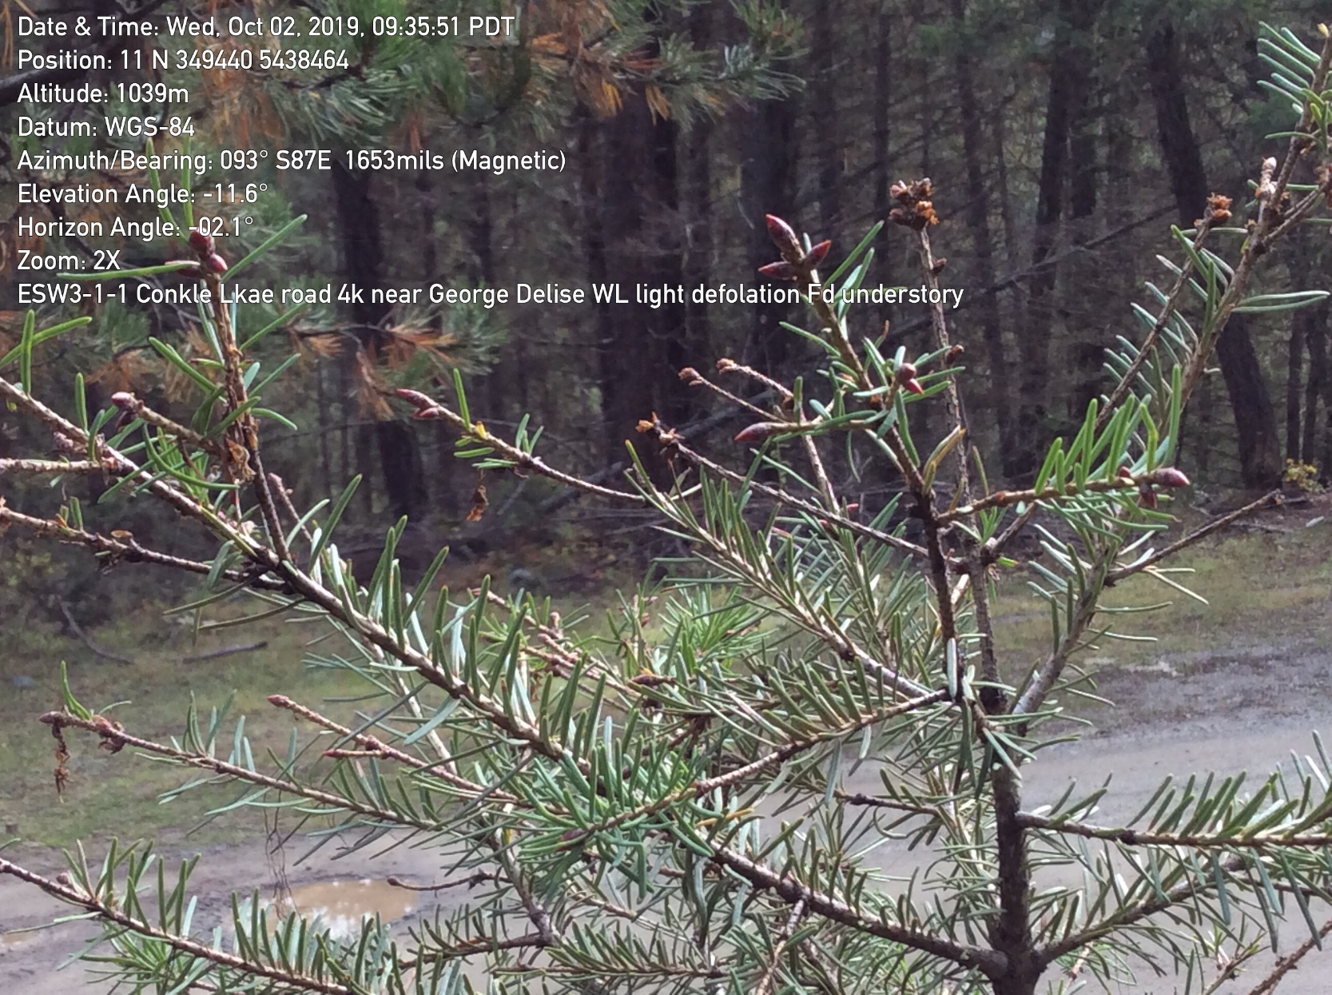
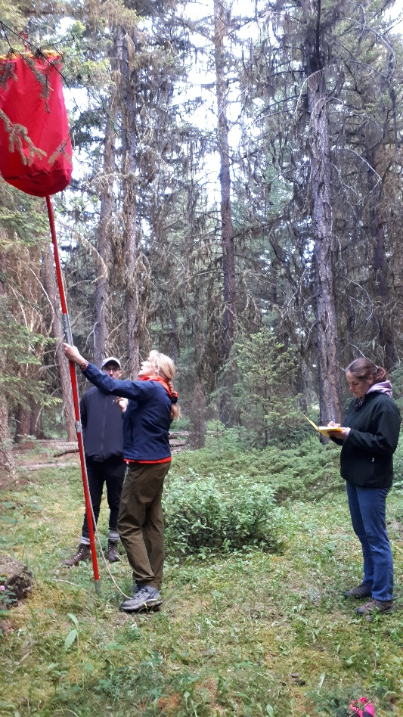
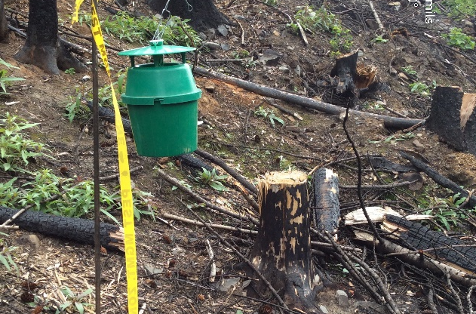
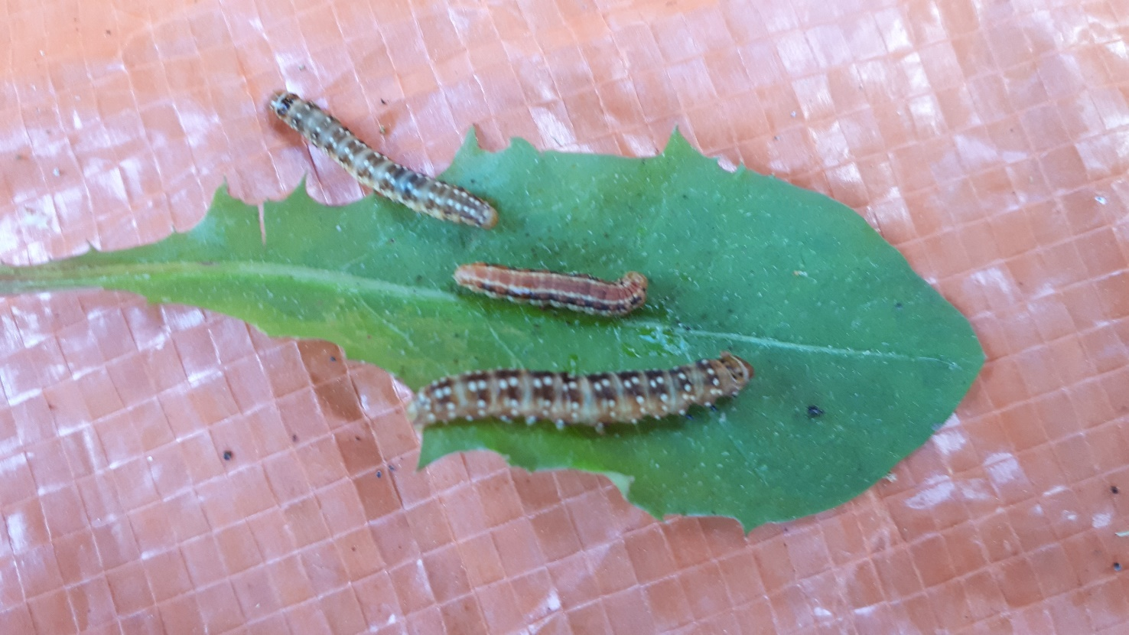
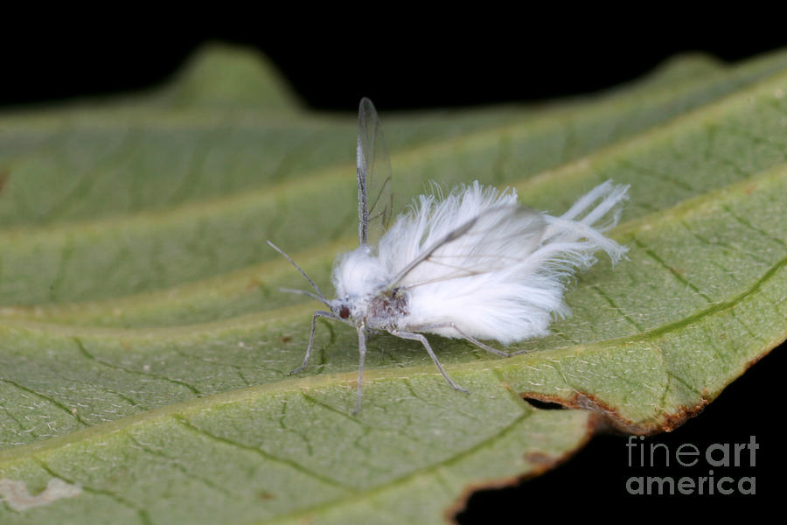
1. Monitor Local FH Conditions
Permanent Monitoring Sites
  Western spruce budworm
  Douglas-fir tussock moth
  Western hemlock looper
  2-year cycle budworm
Temporary Monitoring for emerging issues
  i.e. Black army cutworm (post fire)
Invasive monitoring
  Gypsy moth
  Balsam woolly adelgid

Slide 5
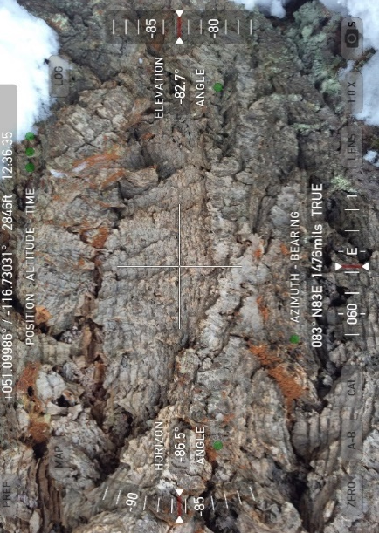
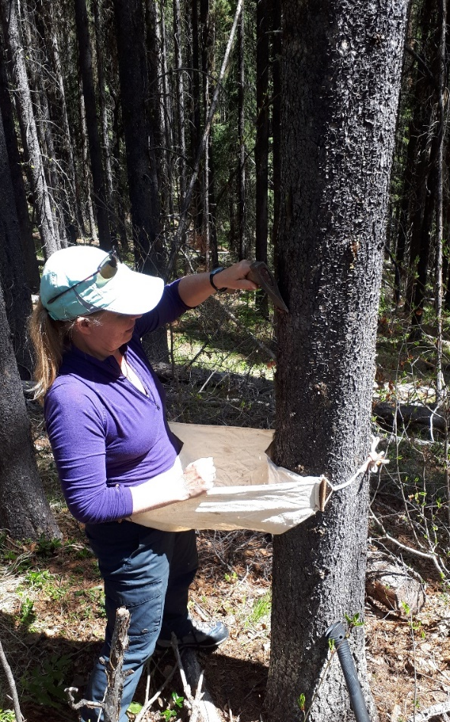
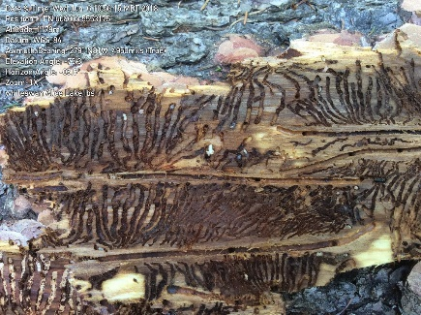
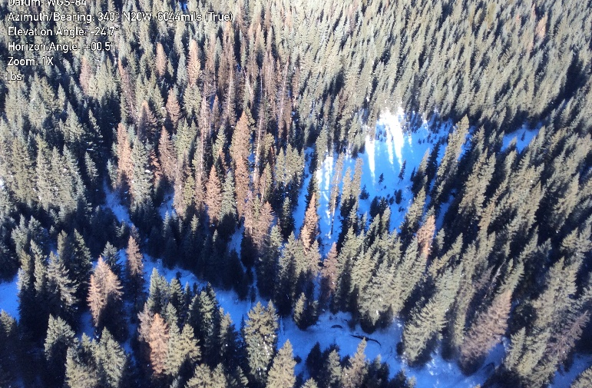
2. Assist in deliver of operational programs with Districts
Forest Health Strategic Plans (all 7 TSAs)
Bark Beetle Programs
  Align operations with Regional/ Provincial direction
  Development of Regional contract standards
  Quality inspections
  Data storage and consistency
  Populations assessments (overwintering mortality predictions)
  Protection Silviculture Research Trial against IBD (2 years MCH)

Slide 6
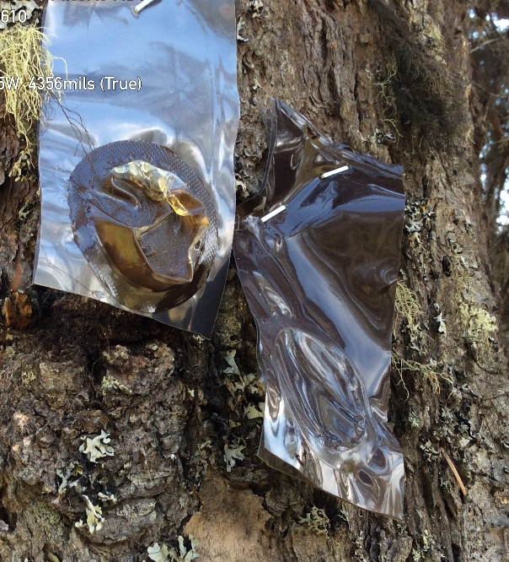
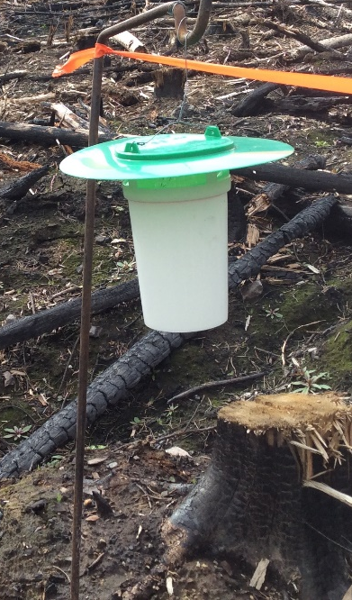
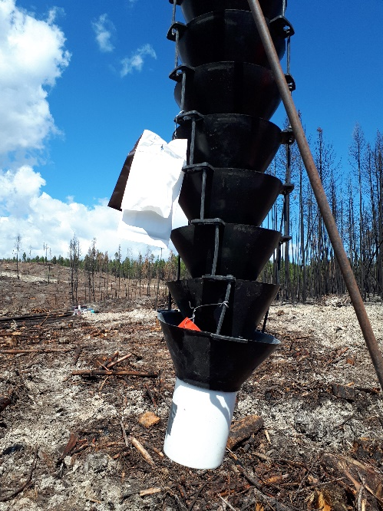
3. Gather and Analyze
Forest Health Research
Douglas-fir beetle – funnel trap lure improvements
Spruce bark beetle – repellent trial
Black army cutworm trap calibrations
Fertilization effects on FH
Pitch moth long term effects
Drought and fire interactions with forest health agents
Long term soil productivity & silviculture trials
Bark beetle cold tolerant research (CFS)
BioSIM for Gypsy moth development (CFS)
Western pine beetle pheromone trials (CFS)

Slide 7
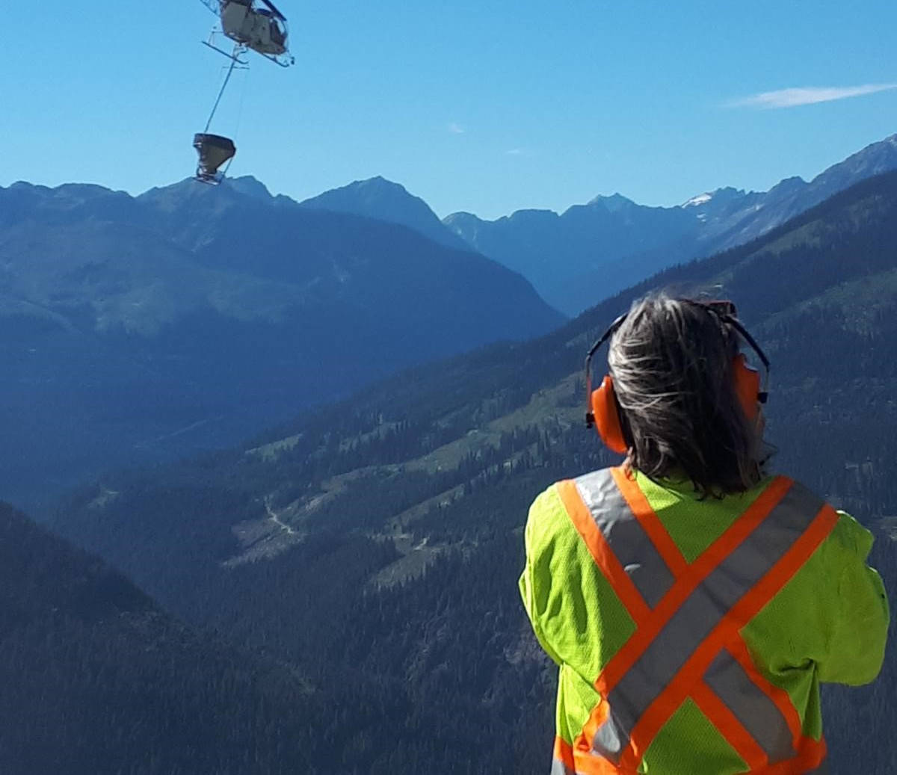
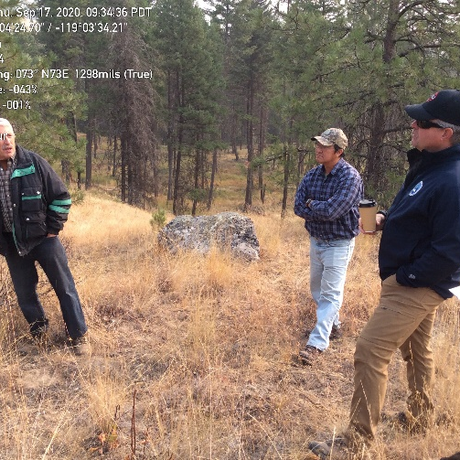
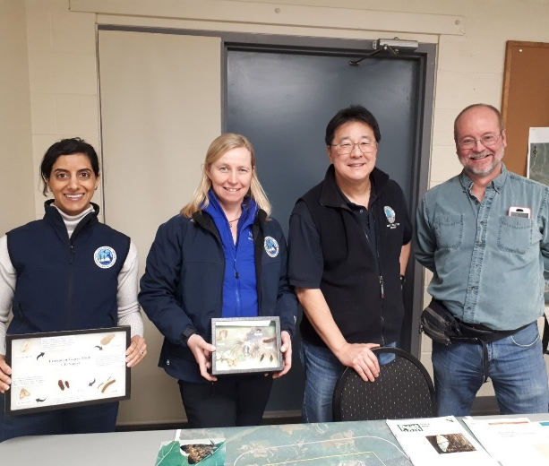
Extension Highlights 2020
4. Provide extension and expert consultative services to local decision makers, industry, and the public
Gypsy moth spray - Open House Castlegar
BC Rep SERG Halifax
Regional Forest Health meetings Creston/ Virtual
Boundary Forest Health Tour Rock Creek
Region & both Districts site visit Golden/ Invermere
Fertilization/ FCI field tour Revelstoke

Slide 8
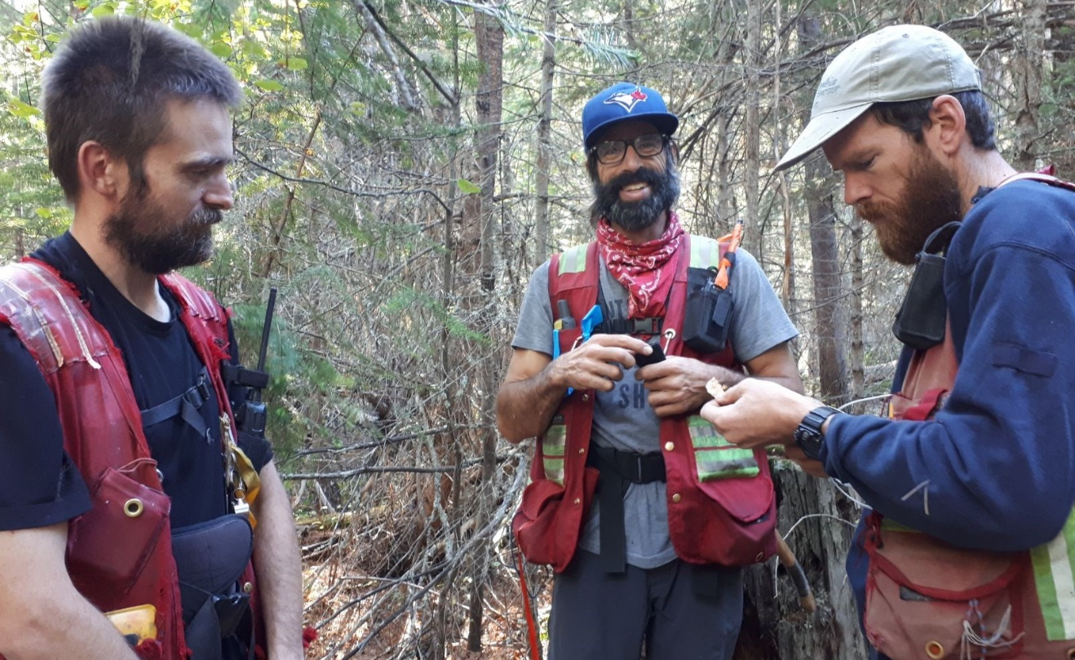
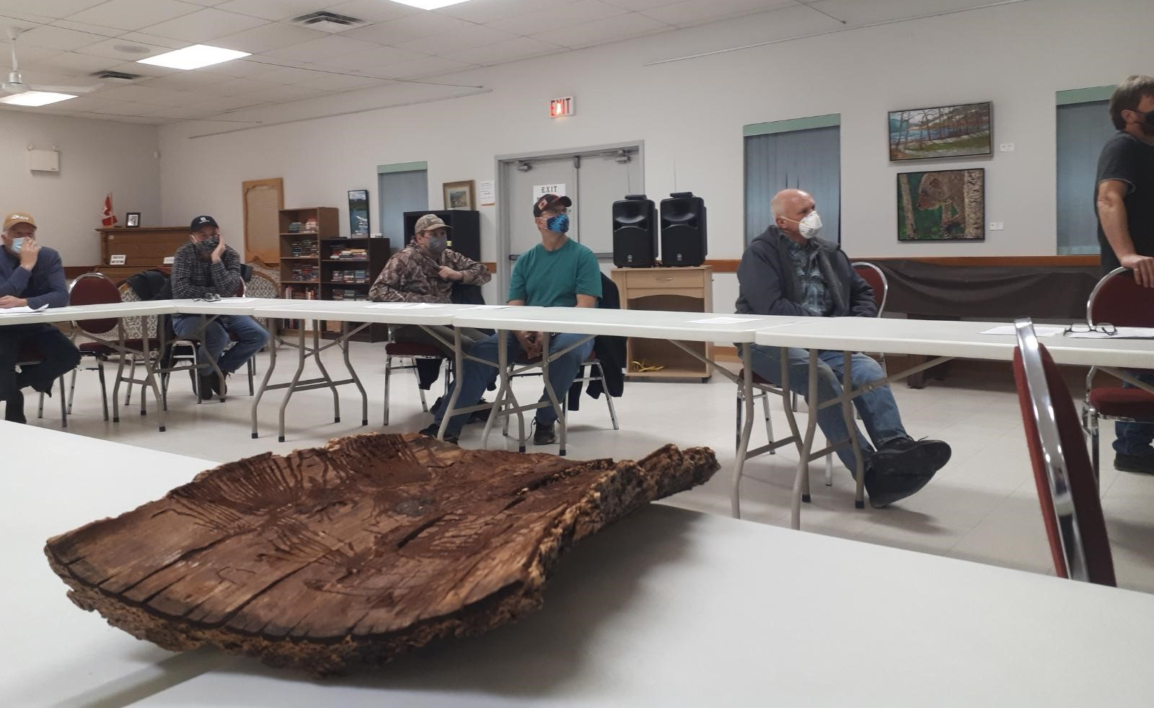
Extension highlights 2020
Bark Beetle training courses Cranbrook/ Nelson
Woodlot meeting Presentation Greenwood /Golden
Cumulative Effects Modelling Elk Valley
Range of Natural Variability Analysis Cranbrook/ Invermere
NA Bark beetle technical working group - IBS repellency trial
Christian Lake Society forest health updates
Numerous TSA working group meetings…..

Slide 9
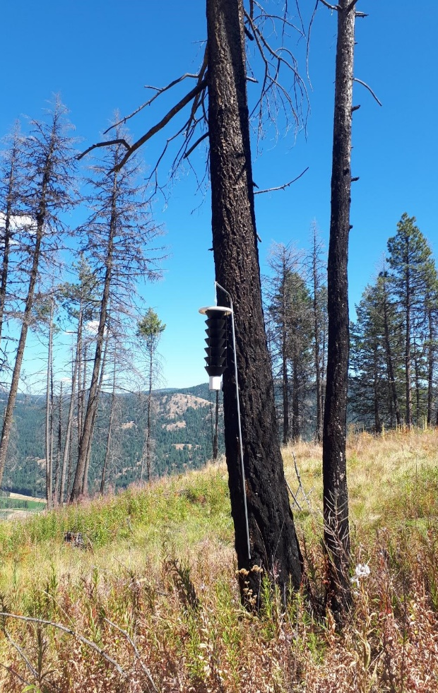
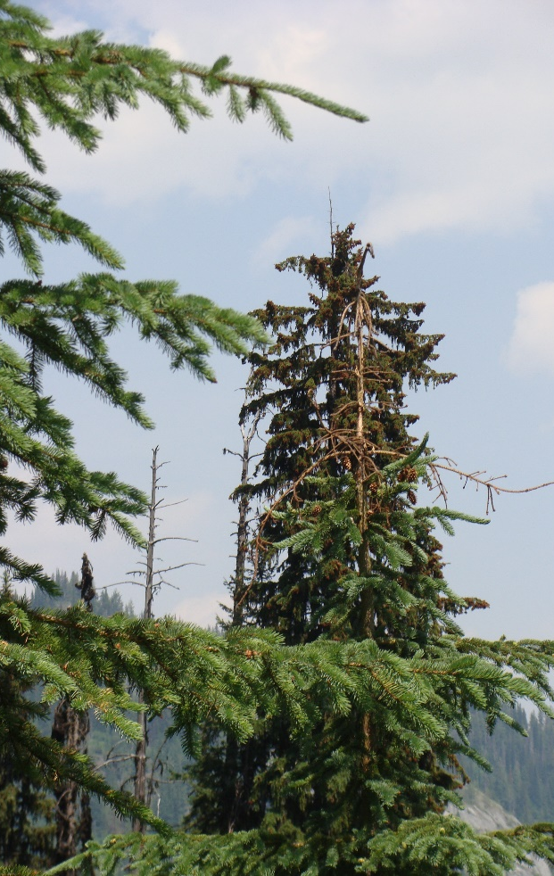
Extension Highlights 2020
Provincial Level
  FH Chief Foresters meeting
  FH White Paper
  Climate change/FH implications
  Health of Young Stand Workshop – organizing committee
  Training material development for YSM
  FRPA Legislation input
  Forest Landscape Level Plan discussion of Forest Health involvement
  Cost/ Benefit Analysis of Douglas-fir beetle treatments
ongoing FH questions for licences, Ministry and private citizens

Slide 10
2020 KBR Bark Beetle Summaries

Slide 11
Historical trends & current issues
Douglas-fir Beetle
Most emerging/ visible issue (drought, fires, and constraints).
Arrow TSA accounts for 1/3 of ha for the Region, biggest jump from 2019 up by 1,363ha
DBO, DIN, DGO, DKL all increased, DCR and DRE decreased

Slide 12
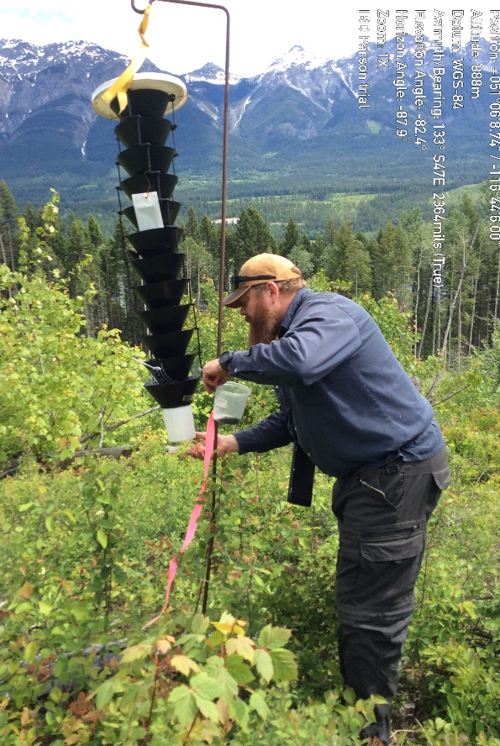
Douglas-fir beetle “lite” lure trial
Funnel trapping effective tactic to reduce IBD but enhanced commercial lure needs 100 m radius opening (4ha)
2 new lures tested in Boundary and Invermere TSAs
70 sites set up Westbridge through to Parson; monitored April through Aug
Most promise with Synergy Lite lure
  strong trap catches
  minimal spill over distance from traps
a
b
b

Slide 13
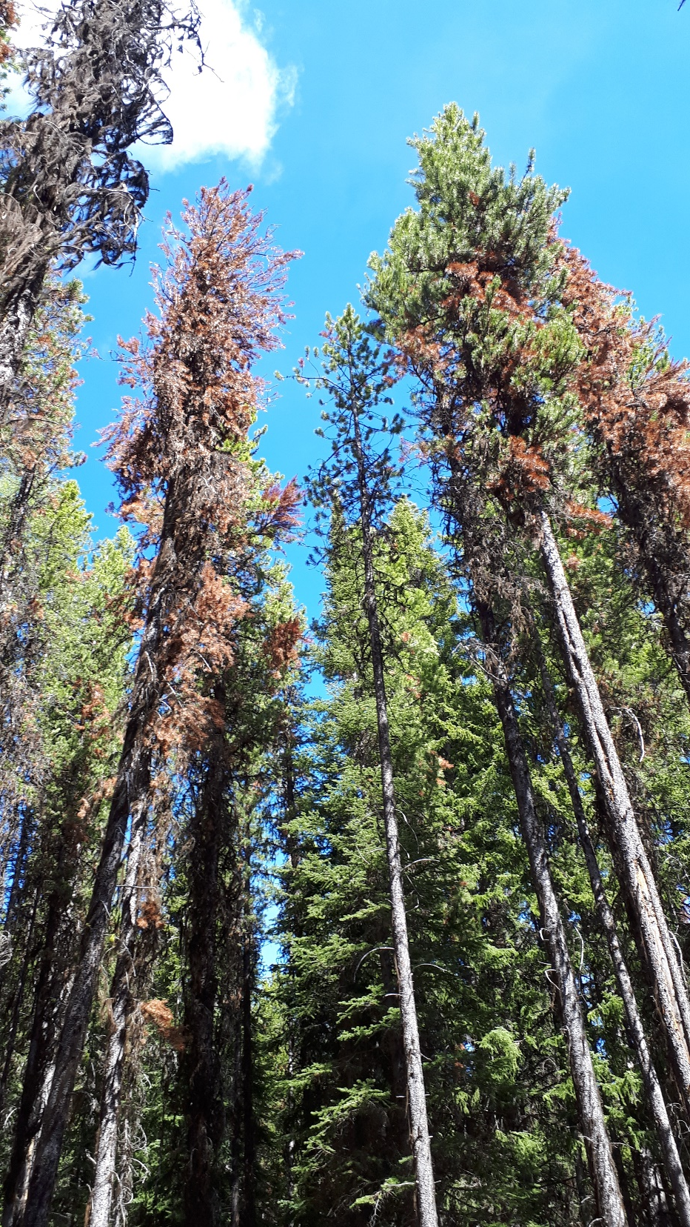
Historical trends & current issues
Mountain Pine Beetle
AOS: IBM decreased in all 7 TSAs in 2020 8,619 ha down from 14,092 ha in 2019 in KBR
However, currently G:R ratios indicate increases in populations, with biggest concern in Invermere, Kootenay Lake (1:1) and Cranbrook (4.5) TSAs

Slide 14
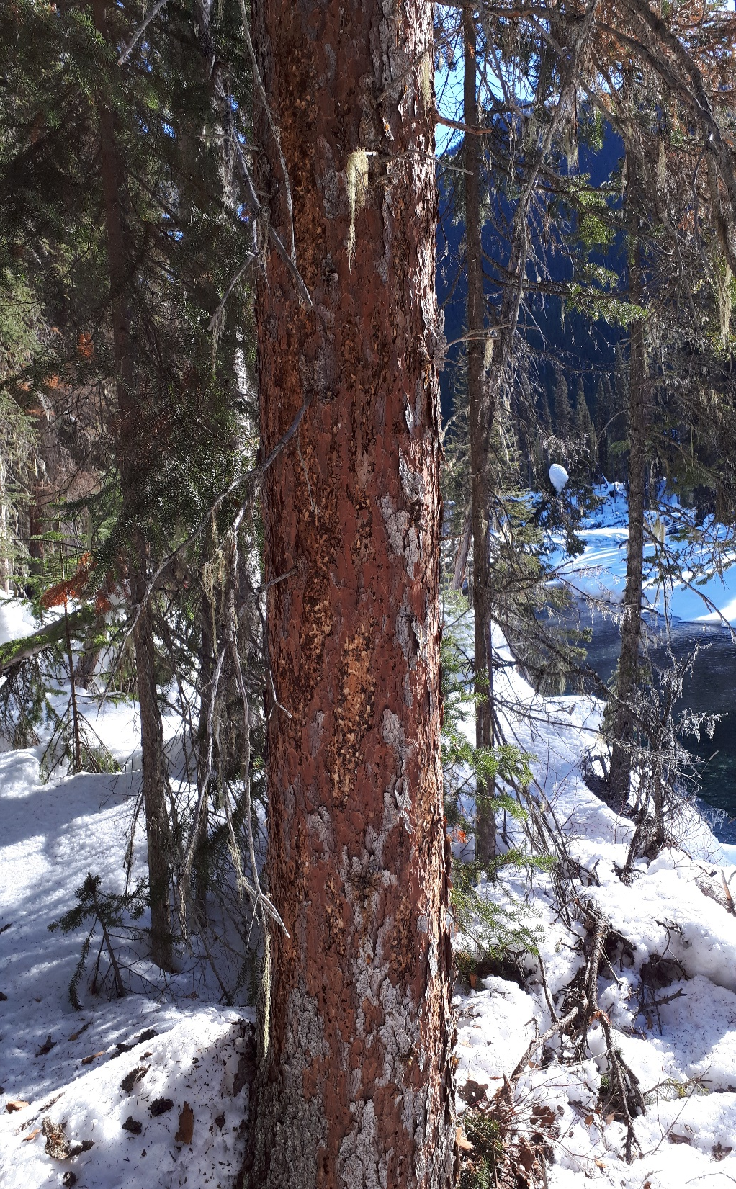
Historical trends & current issues
Spruce Beetle
Invermere, Cranbrook and Golden still substantial populations

Slide 15
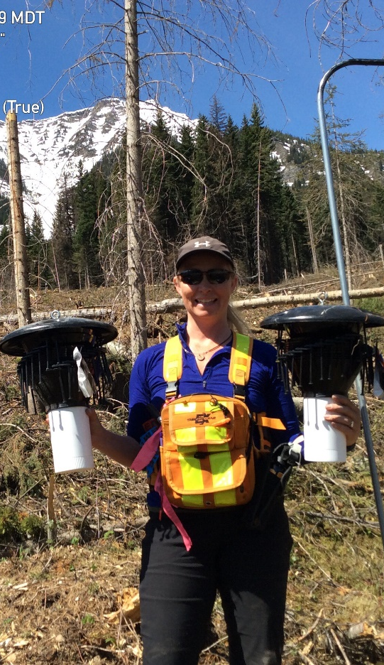
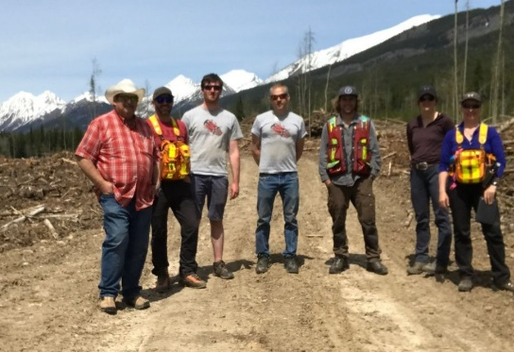
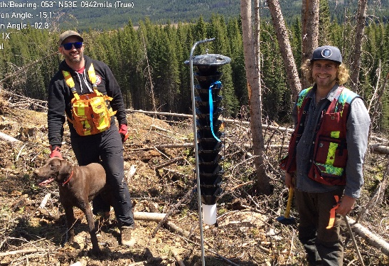
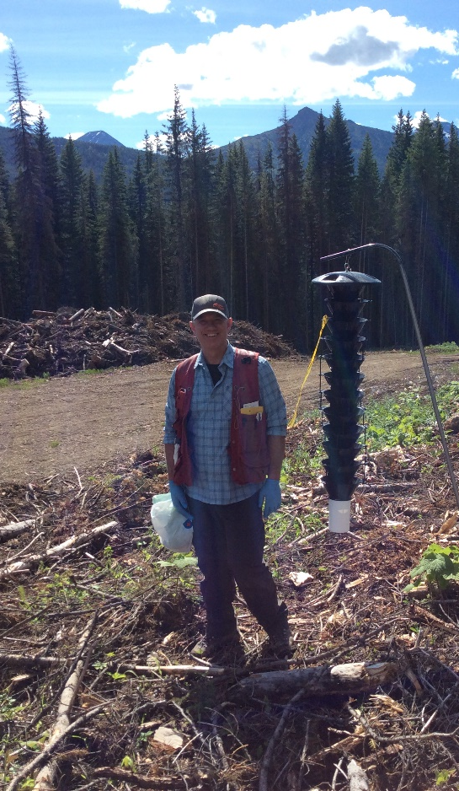
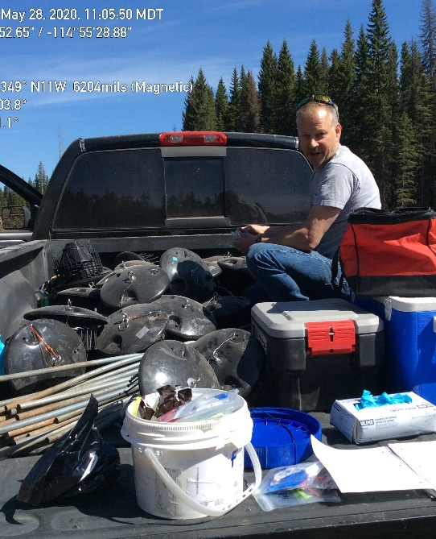
Spruce Beetle Repellency Trapping bioassay – Elk Valley
In Canada we don’t have an effective “repellency treatment” for IBS
This trial tested compounds that showed promise in US Rocky Mountains (UT, CO, WY, NW but didn’t work in AK), plus new compounds
Set up in Elk Valley in collaboration with District staff & Synergy Semiochemicals out of Vancouver – assessed weekly for 5 weeks

Slide 16
Spruce beetle trapping bioassay
5 week collection period
a
a
b
b
b
Trap shut down with 3 compounds
Conophthorin – from bark of deciduous trees
AKB – acer kairomone blend – “maple tree”
-MCH – know repellent IBD

Slide 17
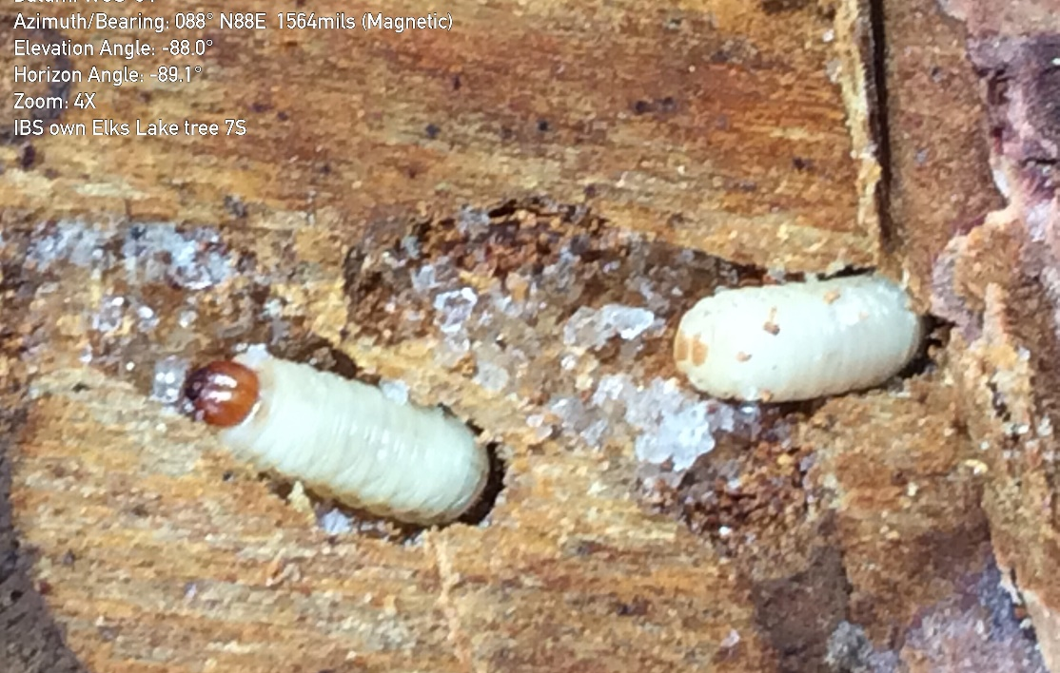
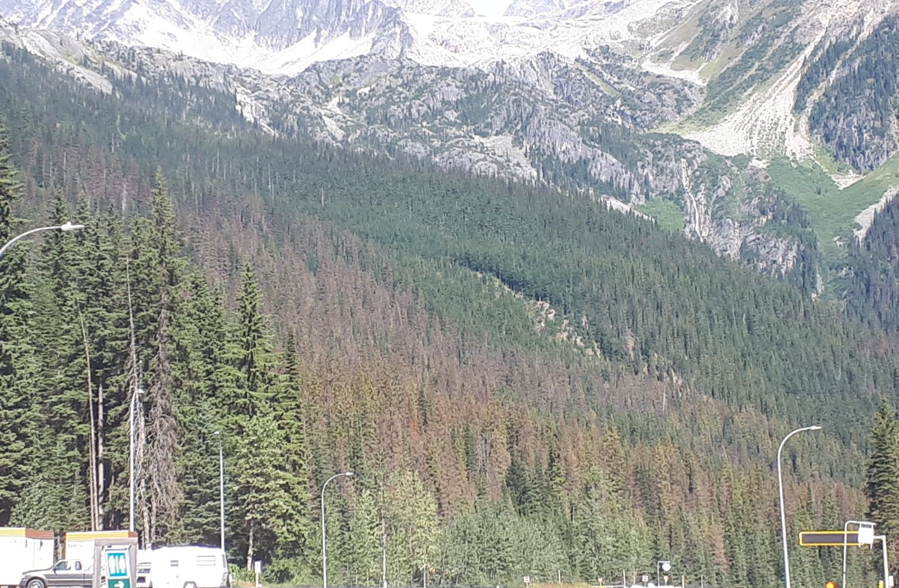
What’s next for spruce beetle repellency trials?
Tree & area Protection Studies 2021
Is conophthorin additive or synergistic with MCH/AKB?
Best methods to deploy MCH/AKB?
  Bubble cap?
  SPLAT MCH?
  Paintball guns?
Glacier National Park IBS

Slide 18
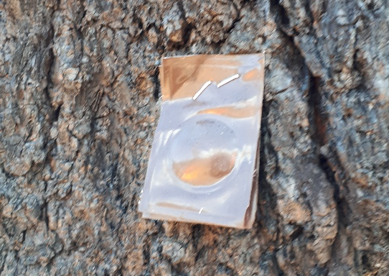
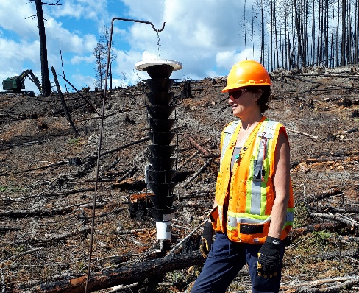
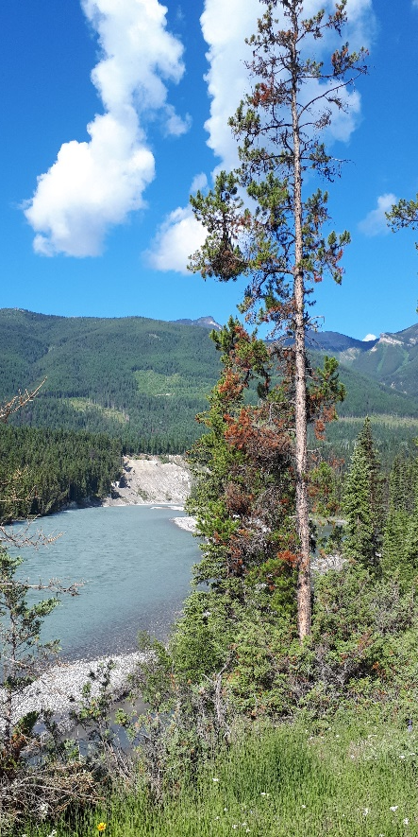
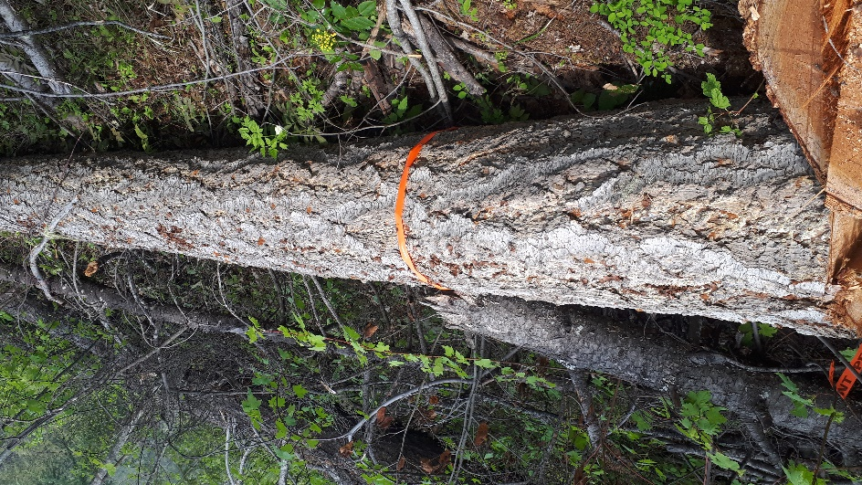
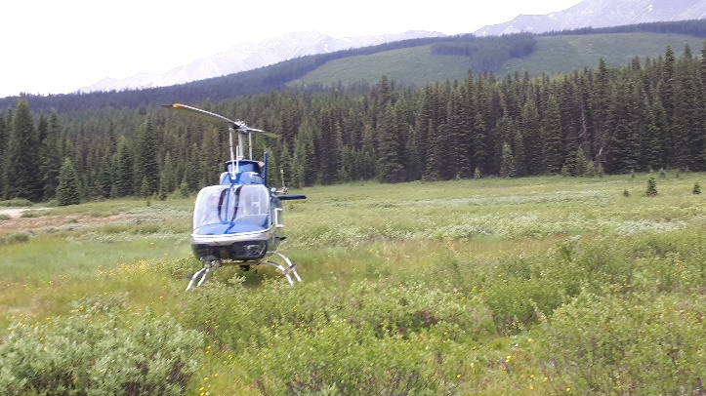
Bark Beetle Program Summaries
2020-2021 Estimates
Activity | DSE | DRM | KBR Total
Detailed aerial survey (ha) | 539,750 | 407,368 | 947.118
Ground surveys (sites) | 267 | 677 | 944
Funnel trapping (sites) IBD (add 70 sites KBR) | 150 | 145 | 365
Trap trees (#s) felled Trap trees (#s) burned | 20 0 | 1,918 468 | 1,938 468
Fall and burn (trees) IBD & IBM | 701 | 1,647 | 2,348
MCH (add 1,230 KBR) | 0 | 250 | 1,480

Slide 19
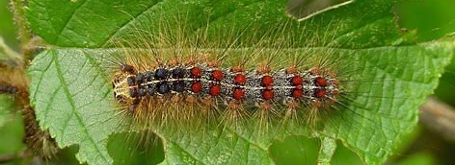

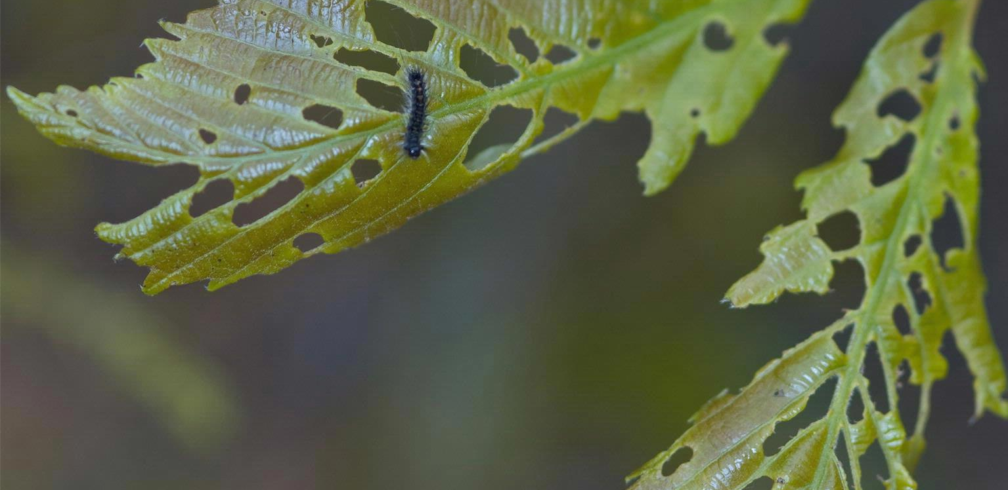
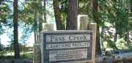
Gypsy Moth - Invasive
One of 100 most destructive invasive species worldwide
BCs highest priority for forest health funding; International trade and export controls require eradication
Host includes 500 species of trees, shrubs and plants
2020 Btk spray areas:
  Surrey
  Campbell River
  Castlegar

Slide 20
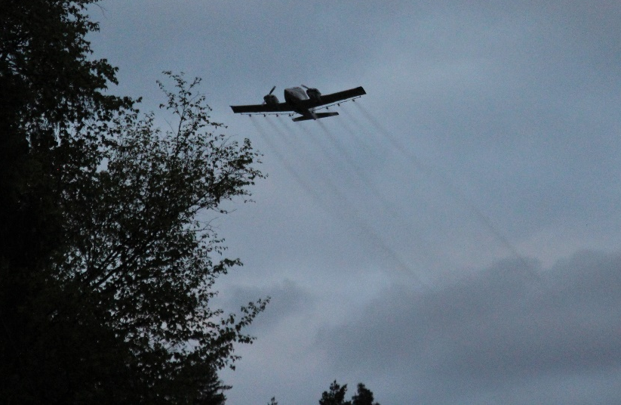
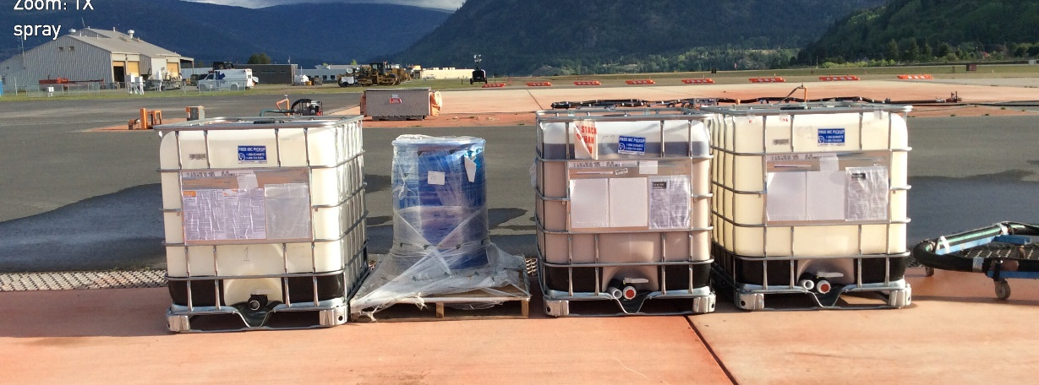
Gypsy moth program timeline of events
Year | What was done | Results
2018 | Annual Regional trapping program | 3 moths trapped - Pass Creek area
2019 | Delamination grid of an additional 43 traps (KBR Teamed with CIFA) | 13 moths caught in 5 traps; one trap caught 9 moths 4 traps caught singles
2019 | Egg mass sampling conducted in fall (KBR/ CFIA) | No egg masses located – like finding needle in hay stack
2020 | 3 sprays May 16th, May 27th, and June 3rd | Only 1 moth caught outside of spray boundary fall 2020!

Slide 21


Slide 22



Western Hemlock Looper
  Native defoliator that can kill trees 1-3 years (Hw, Cw, Fd, Sx, understory, etc.)
  Previous outbreaks have killed 50-96% of trees in severe defoliated sites
  Populations increasing
    significant defoliation predicted 2021
  2021 KBR Potential spray Nakusp, Revelstoke north to Mica
  Last spray 2012 sprayed Btk for protection of Caribou habitat north Revelstoke

Slide 23

Western hemlock looper trap catches 2020
Briefing Note to Chief Forester for $1.17M
KBR 7,000 ha
TOR 29,000 ha
CAR 30,000 ha
Also working with FCI, possible $244K
KBR 6,000 ha outside THLB (Caribou GAR)

Slide 24



Western Spruce Budworm
  Reduces incremental growth, kills tree after multiple years
  Understory most effected
  Numbers still too low to spray in KBR, will continue to monitor

Slide 25



Douglas-fir tussock moth
Populations slightly increasing near Rock Creek, east to Greenwood, and in Midway (Boundary)
Mainly on private land
Kills trees in single year
Health concerns –allergic reaction
Will continue to monitor

Slide 26


2021 PLANS: Fertilization and Forest Health (Spruce Weevil IWS)
2020: 3,000 ha sprayed TFL55/56
2021: 3,000 ha planned DRE TSA
Known effects increased weevil damage at coast and northern BC, however these are the first fertilization sprays in southern BC
Plans to set up 6 tmt & 6 control PSPs Revelstoke to assess potential effects of increased IWS damage on fertilized Sx

Slide 27


2021 PLANS: Petrova (Pitch Moth)/ General FH Conditions PSP Remeasurement DIN
Petrova attacks twigs, terminals and main stem, partially girdles stem – weak points for snow and wind breakage
Higher than normal values in Rocky Mountain Trench late 1990s
Attacks tallest, most vigorous trees whose tops are above canopy level (0.3-3m, but up to 10m height)
Decline when stand age 15-20 years
4 Plots established in 1999; 3 more in 2000, assessed 1999-2001, 2007, 2016
2021 next remeasurement

Slide 28


KBR 2021/2022 FH LIBS Budget Request
 | Gypsy Moth | AOS | SB/DFB | MPB | WSBW | FH Strategy Updates | Monitoring | Hazard Rating | Other (Petrova) | Sub Totals
Kootenay Boundary Region | $8,000 | $189,500 | $15,000 | $14,000 | $419,322 | $0 | $6,500 | $0 | $25,000 | $677,322
Selkirk |  |  | $240,000 | $165,000 |  |  |  |  |  | $405,000
Rocky Mountain |  |  | $581,513 | $392,345 |  | $5,000 |  |  |  | $978,858
Total | $8,000 | $189,500 | $836,513 | $571,345 | $419,322 | $5,000 | $6,500 | $0 | $25,000 | $2,061,180
*
*
Potential uplifts in 2021/2022;
  FH Strategy updates DRM $5k
  IDL Btk sprays $411k
  Petrova assessments $21k
  Total $437k increase

Slide 29


2020
Challenges/ Solutions
Issue | Challenge | Possible Solution
LBIS budget clawbacks (10% wage offset) | Found out mid-way through season, limited time for adjustments. Only Region this happened in. | Know upfront so adjustments can be made to budget requests/ changes to programs or leave $
Auxiliary Research Technician | Existing tech has heavy workload, limited availability 4 of 5 Regional Entomologist Provincially have either dedicated or shared Technician | Shared auxiliary technician with DRM District?
Regional Research Co-op position | 2020 position cancelled after person hired/ projects planned | Hire for 2021? Auxiliary or contract work? Share with Revelstoke co-op?
GIS support | Fitting into Region/ District que | Research tech with GIS skills? Request for quote for urgent matters?
Security/ Safety sprays | death threats, last minute withdrawal of NRO support | Planned support?

